Slide 1
Innovation in Computer Science
Blockchain

Slide 2
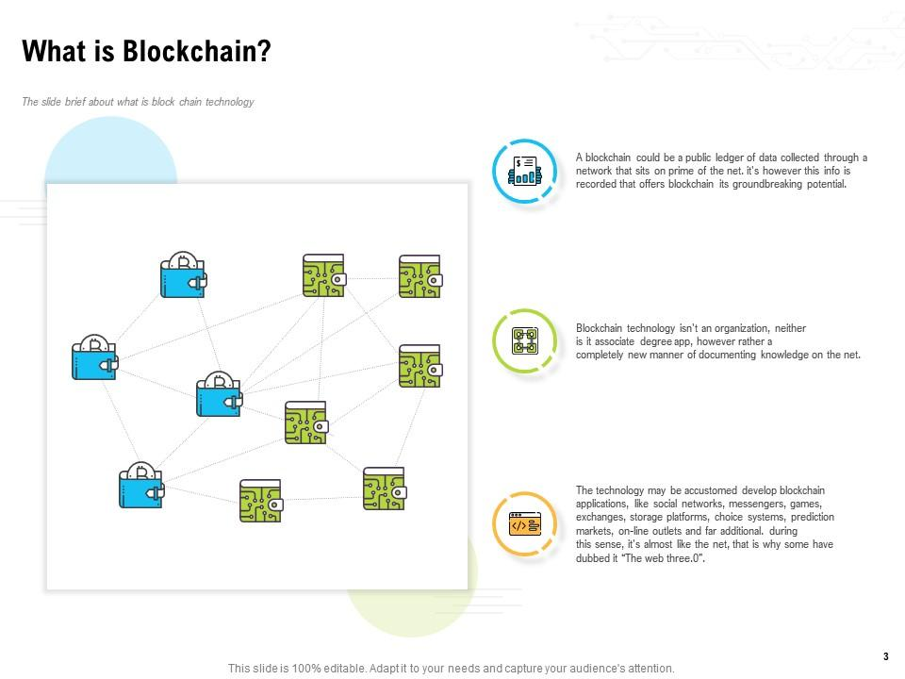
Template 1: What is Blockchain?

Slide 3
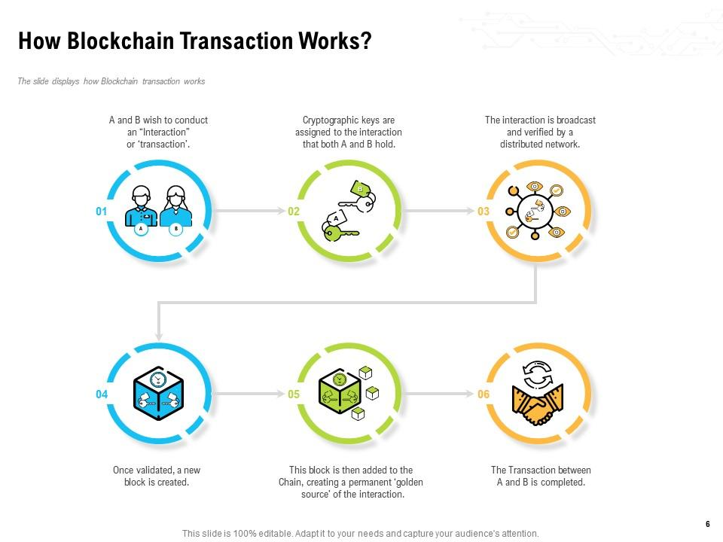
Template 2: How Blockchain Transaction Works?

Slide 4
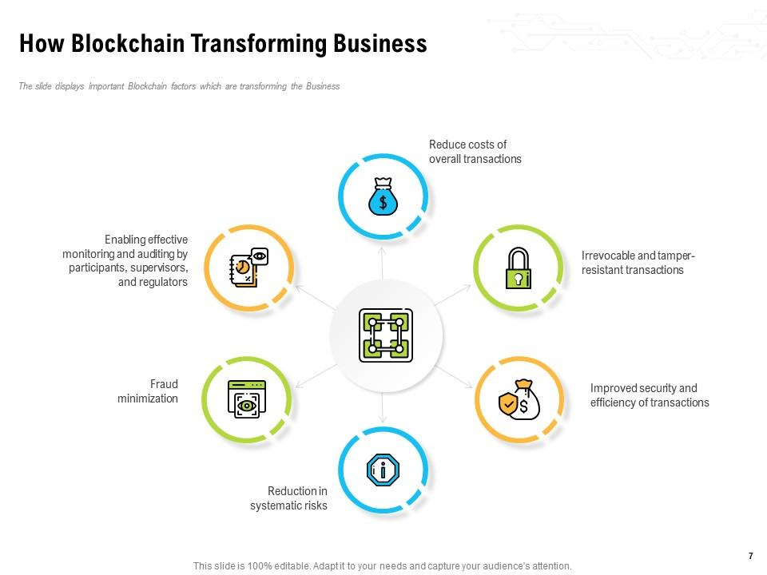
Template 3: How is Blockchain Transforming Business

Slide 5
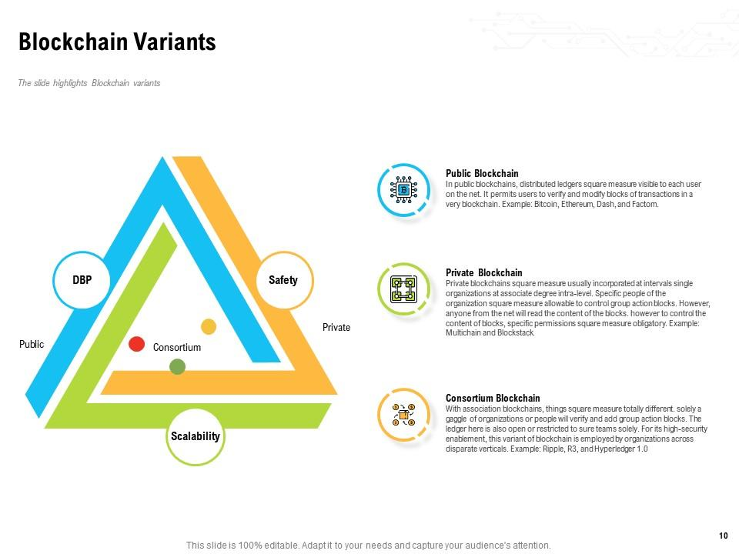
Template 4: Blockchain Variants

Slide 6
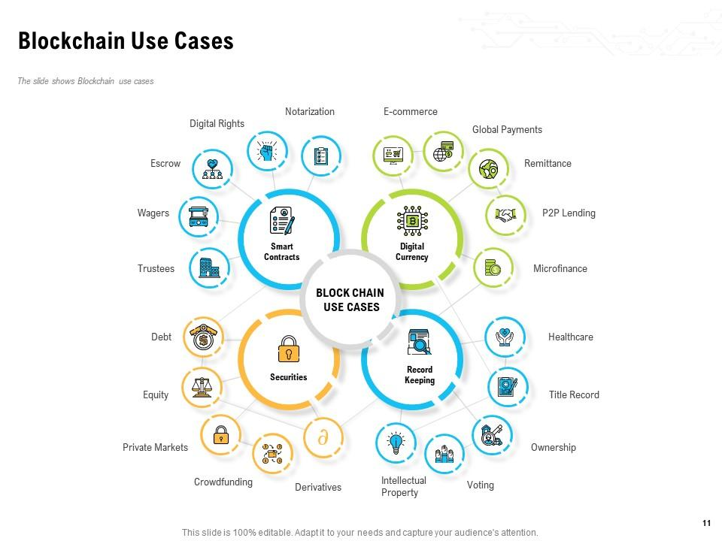
Template 5: Blockchain Use Cases

Slide 7
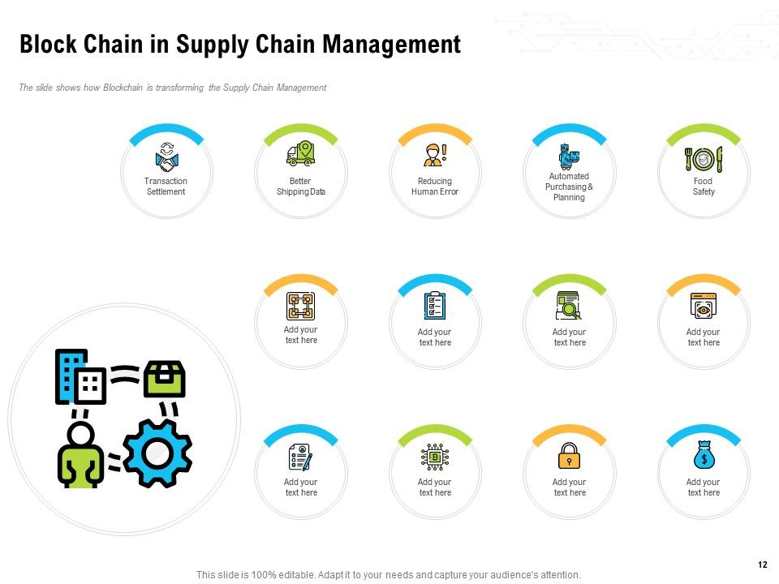
Template 6: Blockchain in Supply Chain Management

Slide 8
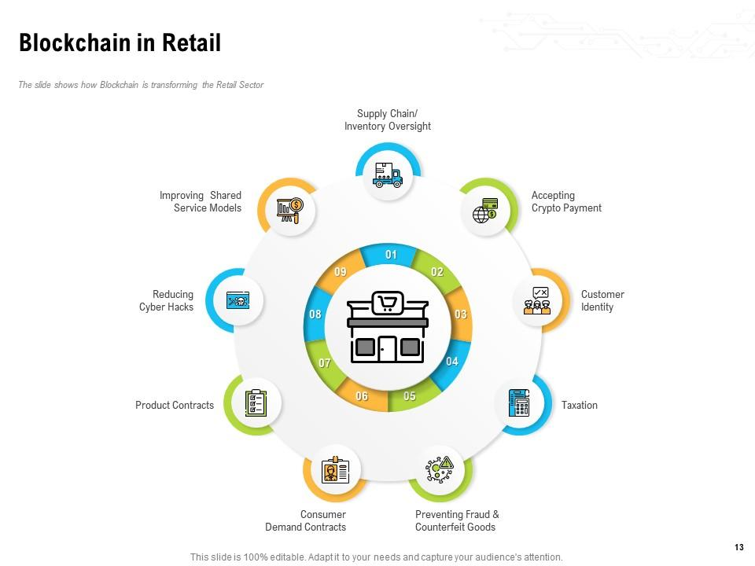
Template 7: Blockchain in Retail

Slide 9
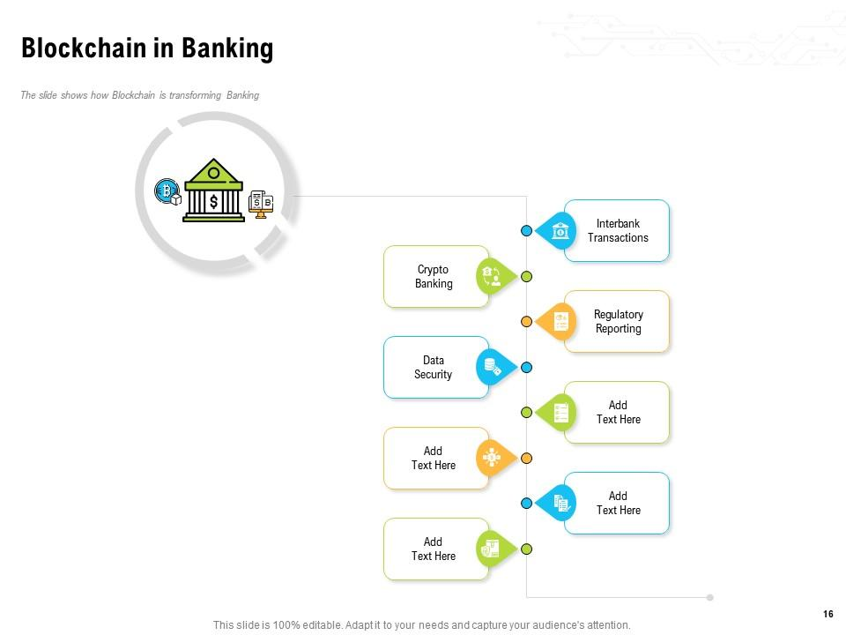
Template 8: Blockchain in Banking

Slide 10
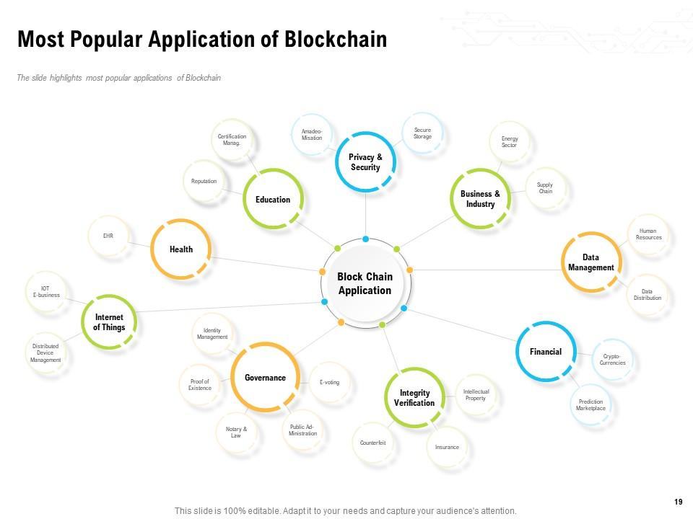
Template 9: Most Popular Applications of Blockchain

Slide 11
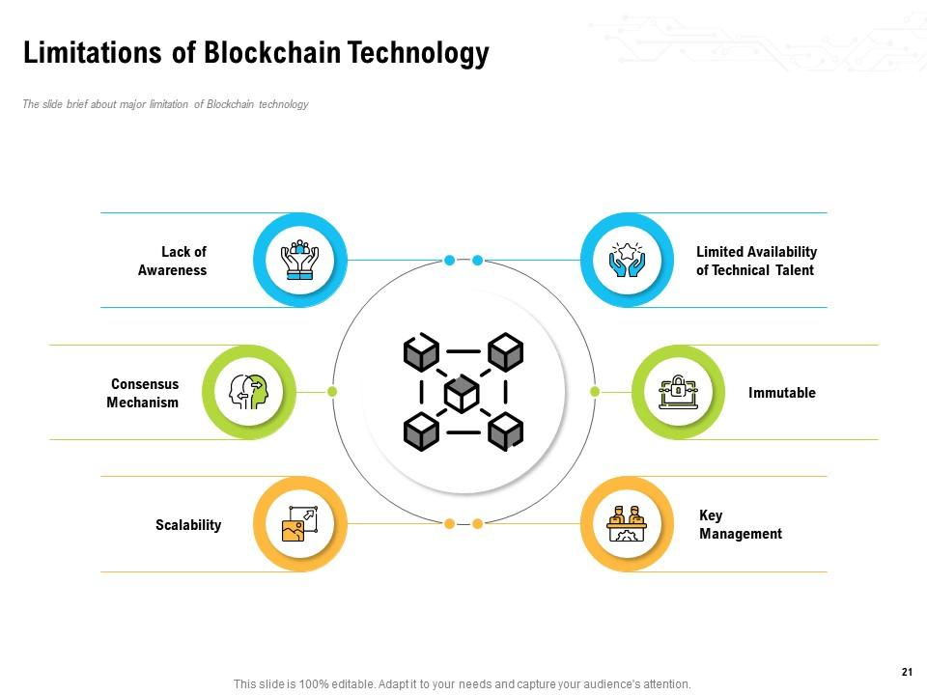
Template 10: Limitations of Blockchain Technology

